Slide 1
http module
Anju munoth

Slide 2
http module
Another core module of Node.js!
HTTP interface is similarly low-level when compared with frameworks or languages such as PHP in order to keep it fast and flexible.

Slide 3
HTTP core module is a key module to Node networking.
Properties
http.METHODS
http.STATUS_CODES
http.globalAgent
Methods
http.createServer()
http.request()
http.get()
Classes
http.Agent
http.ClientRequest
http.Server
http.ServerResponse
http.IncomingMessage

Slide 4
HTTP.METHODS
This property lists all the HTTP methods supported:
> require('http').METHODS

Slide 5
HTTP.STATUS_CODES
This property lists all the HTTP status codes and their description:
> require('http').STATUS_CODES
{ '100': 'Continue',
'101': 'Switching Protocols',
'102': 'Processing',
'200': 'OK',
'201': 'Created',………………..

Slide 6
HTTP.GLOBALAGENT
Points to the global instance of the Agent object, which is an instance of the http.Agent class.
It’s used to manage connections persistance and reuse for HTTP clients, and it’s a key component of Node HTTP networking.

Slide 7
HTTP methods
HTTP.REQUEST()
Makes an HTTP request to a server, creating an instance of the http.ClientRequest class.
HTTP.GET()
Similar to http.request(), but automatically sets the HTTP method to GET, and calls req.end() automatically.

Slide 8
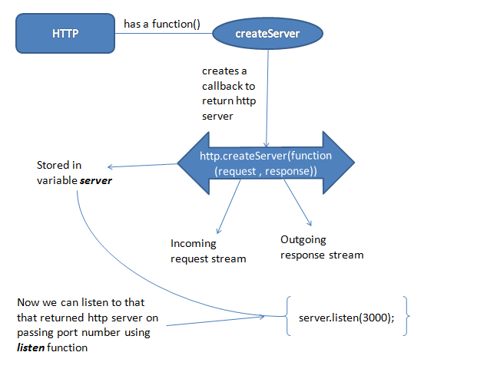

Slide 9
createServer()
http module has its main function , createServer , which takes a callback and returns an HTTP server.
On each client request, the callback is passed in two arguments — the incoming request stream and an outgoing server response stream.
To start the returned HTTP server, simply call its listen function passing in the port number you want to listen on.
By running code node filename.js would simply start the server using node.js

Slide 10
createServer()
var http = require('http');
var server = http.createServer(function (request, response) {
console.log('request starting...');
// respond
response.write('hello client!');
response.end();
});
server.listen(3000);
console.log('Server running at http://127.0.0.1:3000/');

Slide 11
CLASSES
The HTTP module provides 5 classes:
http.Agent
http.ClientRequest
http.Server
http.ServerResponse
http.IncomingMessage

Slide 12
HTTP.AGENT
Node creates a global instance of the http.Agent class to manage connections persistance and reuse for HTTP clients, a key component of Node HTTP networking.
This object makes sure that every request made to a server is queued and a single socket is reused.
It also maintains a pool of sockets. This is key for performance reasons.

Slide 13
HTTP.CLIENTREQUEST
An http.ClientRequest object is created when http.request() or http.get() is called.
When a response is received, the response event is called with the response, with an http.IncomingMessage instance as argument.
The returned data of a response can be read in 2 ways:
Can call the response.read() method
in the response event handler you can setup an event listener for the data event, so you can listen for the data streamed into.

Slide 14
HTTP.SERVER
This class is commonly instantiated and returned when creating a new server using http.createServer().
Once you have a server object, you have access to its methods:
close() stops the server from accepting new connections
listen() starts the HTTP server and listens for connections

Slide 15
HTTP.SERVERRESPONSE
Created by an http.Server and passed as the second parameter to the request event it fires.
Commonly known and used in code as res:
const server = http.createServer((req, res) => {
//res is an http.ServerResponse object
})
Will always call in the handler is end(), which closes the response, the message is complete and the server can send it to the client.
It must be called on each response

Slide 16
methods used to interact with HTTP headers:
getHeaderNames() get the list of the names of the HTTP headers already set
getHeaders() get a copy of the HTTP headers already set
setHeader('headername', value) sets an HTTP header value
getHeader('headername') gets an HTTP header already set
removeHeader('headername') removes an HTTP header already set
hasHeader('headername') return true if the response has that header set
headersSent() return true if the headers have already been sent to the client

Slide 17
Response.writeHead()
After processing the headers you can send them to the client by calling response.writeHead(),
which accepts the statusCode as the first parameter, the optional status message, and the headers object.

Slide 18
Response
To send data to the client in the response body, you use write().
It will send buffered data to the HTTP response stream.
If the headers were not sent yet using response.writeHead(), it will send the headers first, with the status code and message that’s set in the request, which you can edit by setting the statusCode and statusMessage properties values:
response.statusCode = 500
response.statusMessage = 'Internal Server Error'

Slide 19
HTTP.INCOMINGMESSAGE
An http.IncomingMessage object is created by:
http.Server when listening to the request event
http.ClientRequest when listening to the response event
It can be used to access the response:
status using its statusCode and statusMessage methods
headers using its headers method or rawHeaders
HTTP method using its method method
HTTP version using the httpVersion method
URL using the url method
underlying socket using the socket method
The data is accessed using streams, since http.IncomingMessage implements the Readable Stream interface.

Slide 20
Pros and cons of http module
Much of the HTTP, and the HTTPS, module’s functionality is fairly low-level.
Required to receive response data in chunks rather than just providing a callback function to be executed as soon as all of the data is received.
You also need to parse the response data manually. This is fairly trivial if it is JSON formatted, but it is still an extra step.
One other problem is that this module does not support HTTPS by default, so we need to require the https module instead if the API we are using communicates over HTTPS.
It may take a bit more effort to get the data you want, but is a great utility if you don’t want to add too many dependencies to your codebase or want access to its low level functionality.

